Slide 1

Big data and Data Science
Chantana Chantrapornchai
Dept. of Computer Engineering
Kasetsart University

Slide 2
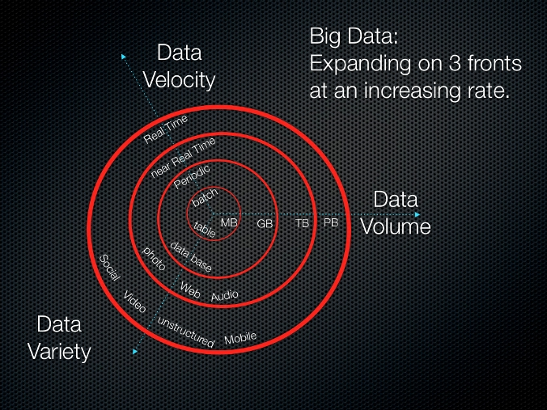
What is Big Data? - 3 V’s
• Big Volume
— With simple (SQL) analytics
— With complex (non-SQL) analytics
• Big Velocity
— How fast data is processed
• Big Variety
— Large number of diverse data sources to integrate
http://whatis.techtarget.com/definition/3Vs
http://www.dummies.com/how-to/content/defining-big-data-volume-velocity-and-variety.html

Slide 3
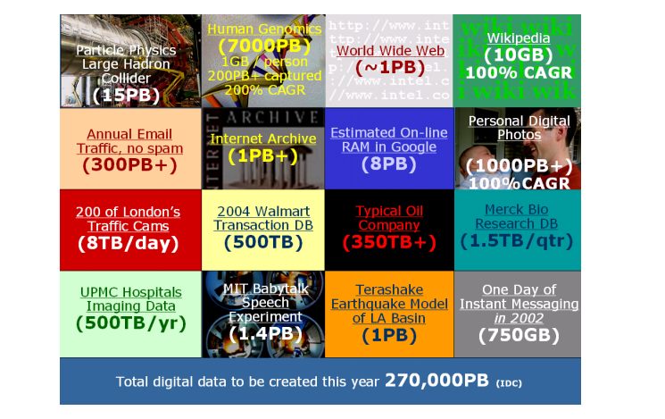
Compound Annual Growth Rate: CAGR
http://www.investopedia.com/terms/c/cagr.asp

Slide 4
12 big facts about big data
1. If you stacked a pile of CD-ROMs on top of one another until you’d reached the current global storage capacity for digital information – about 295 exabytes – if would stretch 80,000 km beyond the moon.
2 Every hour, enough information is consumed by internet traffic to fill 7 million DVDs. Side by side, they’d scale Mount Everest 95 times.
3247 billion e-mail messages are sent each day… up to 80% of them are spam.
4 By 2020, IT departments will be looking after 10 x more servers, 50 x more data and 75 x more files. Meanwhile, the number of IT administrators keeping track of all that data growth with increase by 1.5 times.
5 We can expect a 40-60 per cent projected annual growth in the volume of data generated, while media intensive sectors, including financial services, will see year on year data growth rates of over 120 per cent.
6The world’s 500,000+ data centres are large enough to fill 5,955 football fields.
775% of digital information is generated by individuals, whilst enterprises have liability for 80% of digital data at some point in its life.
8 There are nearly as many bits of information in the digital universe as there are stars in our actual universe.
9 Investment in digital enterprises has increased 50% since 2005.
10 There are 30 billion pieces of content shared on Facebook every day.
11 In 2010, 28% of the digital universe required some level of security… not all of it had the level of security it required….
12 People wishing each other Happy New Year drove a 500% surge in smartphone data within just one year, according to 3UK whose customers used a whopping 80 terabytes (TB) on the 31st December 2011, compared to just 14 TBs on the same day in 2010.
จำนวน storage ที่ใช้
จำนวนข้อมูลที่ไหลบน Internet
จำนวน server ที่ใช้
ปริมาณที่เพิ่มขึ้นทุกปี
ขนาด data center
การลงทุนในหน่วยงานเพิ่มขึ้น 50%
จำนวนข้อมูลที่ shared บน facebook ทุกวัน
ความต้องการ security
จำนวน ข้อมูลที่ส่งบน mobile ในวันปีใหม่
http://blog.kurtosys.com/12-big-facts-about-big-data/#.VBszDBY4S-J

Slide 5
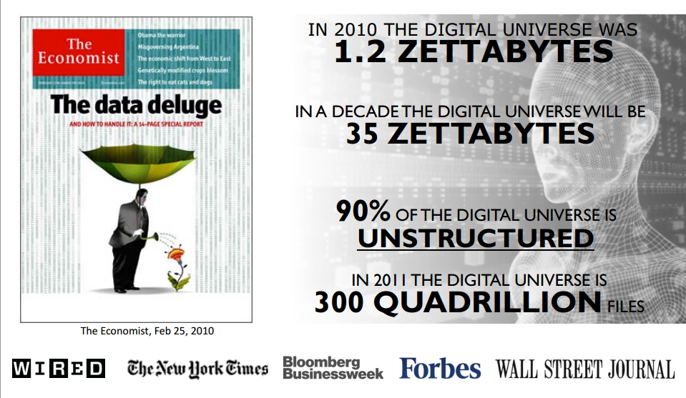
http://www.snia.org/sites/default/files2/ABDS2012/Tutorials/RobPeglar_Introduction_Analytics%20_Big%20Data_Hadoop.pdf

Slide 6
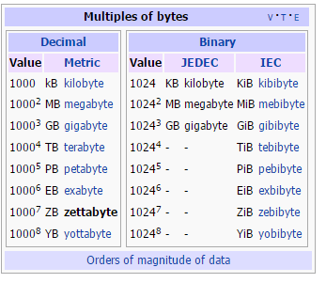
How big?
1 ZB = 1000⁷bytes = 10²¹ bytes = 1000000000000000000000 bytes = 1000 exabytes = 1 billion tera bytes.
http://en.wikipedia.org/wiki/Zettabyte

Slide 7
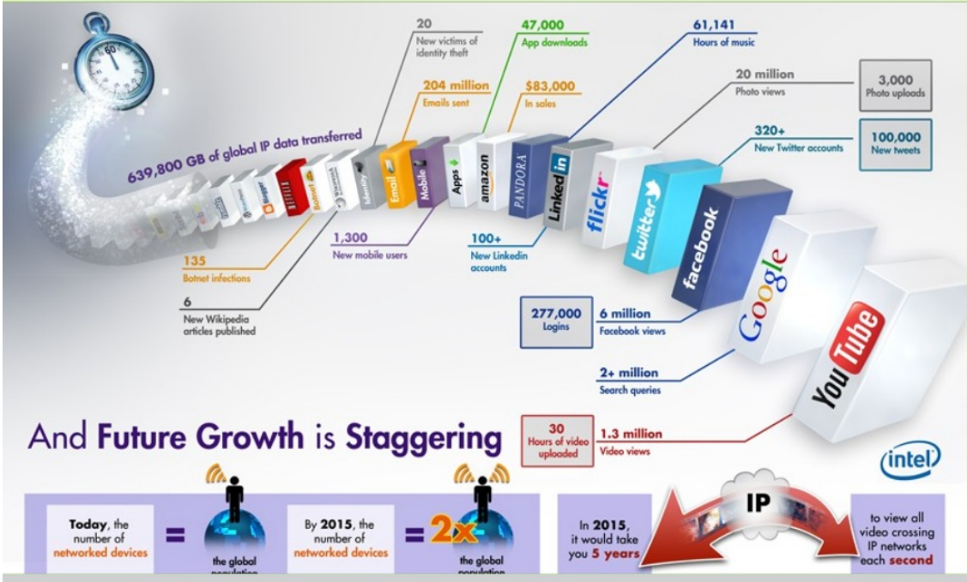

Slide 8
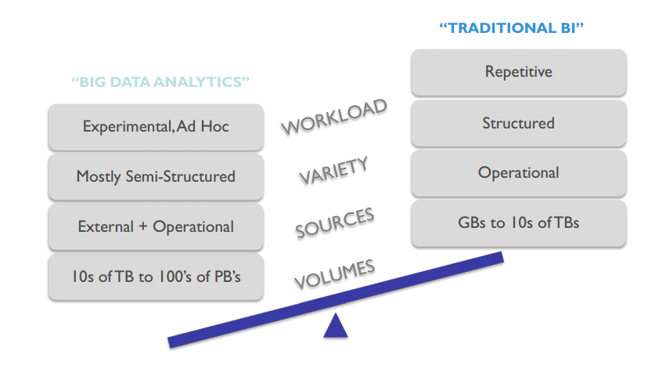
Processing big data: Differences from traditional BI

Slide 9
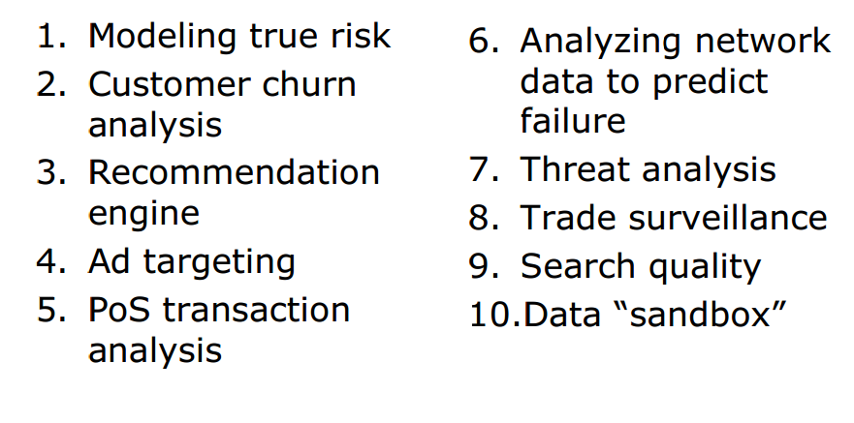
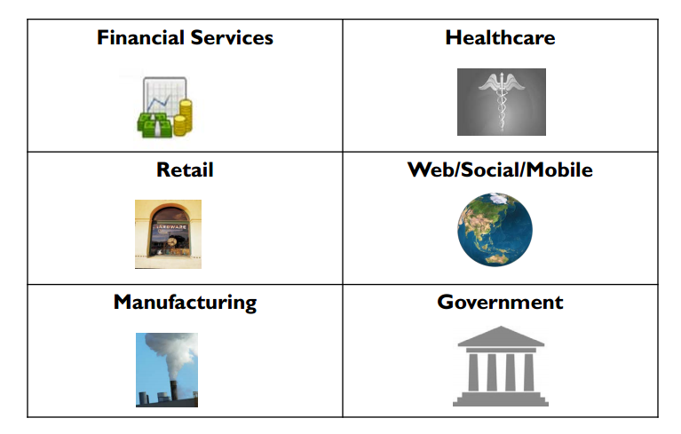
Ten commons applications

Slide 10
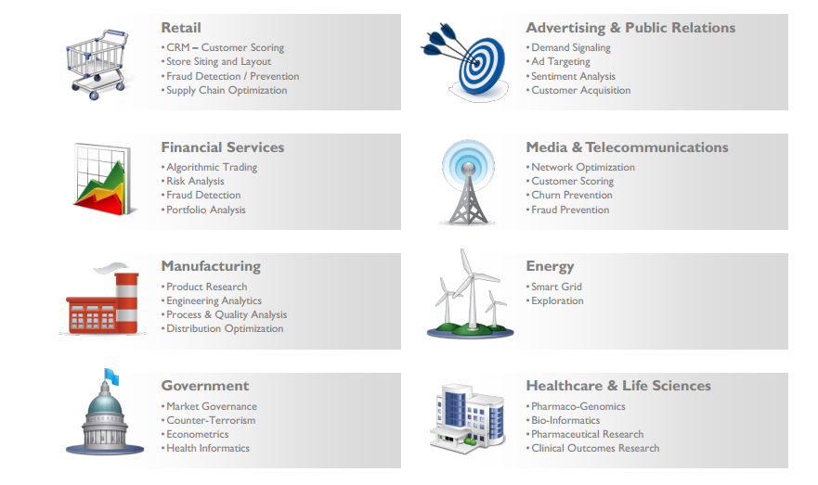

Slide 11
Categories of Big Volumes
With no analytics
With analytics

Slide 12
Big volumes – no analytics
Well addressed by data warehouse crowd
Who are pretty good at SQL analytics on
— Hundreds of nodes
— Petabytes of data
Column stores may be a good solution.
• Factor of 50 or so faster than row stores

Slide 13
Big data- big analytics
Complex math operations (machine learning, clustering, trend detection, ….)
— the world of the “quants” (Quantitative analyst)
— Mostly specified as linear algebra on array data
• A dozen or so common ‘inner loops’
— Matrix multiply
— QR decomposition
— SVD decomposition (Singular value decomposition)
— Linear regression
http://www.forbes.com/sites/investopedia/2013/06/07/quants-the-rocket-scientists-of-wall-street/

Slide 14
Big Velocity
การซื้อขายในตลาดหุ้น
Trading volumes going through the roof on Wall Street
– breaking infrastructure
Sensor tagging of {cars, people, …} creates a firehose to ingest
The web empowers end users to submit transactions
– sending volume through the roof
PDAs lets them submit transactions from anywhere….

Slide 15
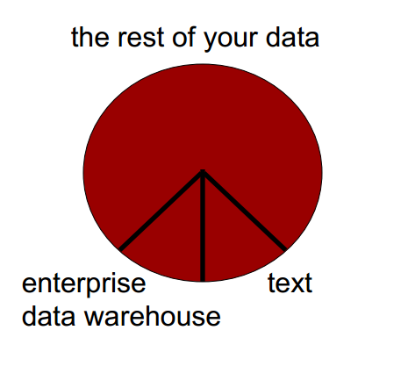
Big Variety
Typical enterprise has 5,000 operational systems
— Only a few get into the data warehouse
— What about the rest?
And what about all the rest of your data?
— Spreadsheets
— Access databases
— Web pages
• And public data from the web?
All data integrations

Slide 16
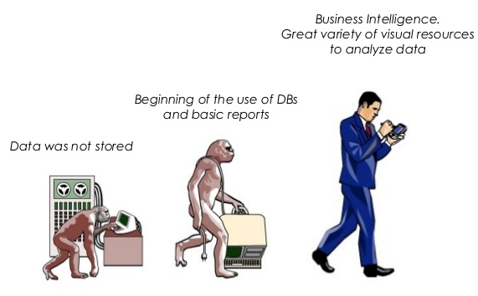
Information History
http://www.slideshare.net/zanorte/big-data-analytics-2013

Slide 17
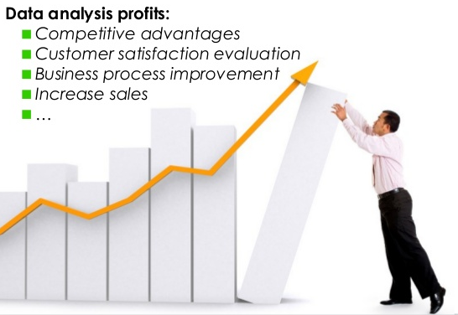

Slide 18
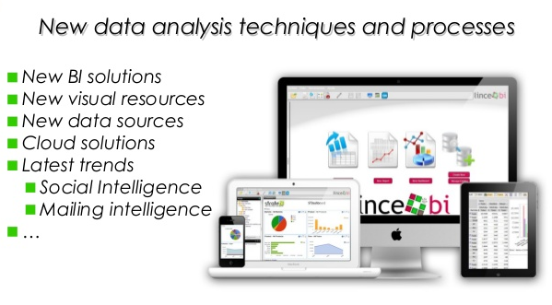

Slide 19
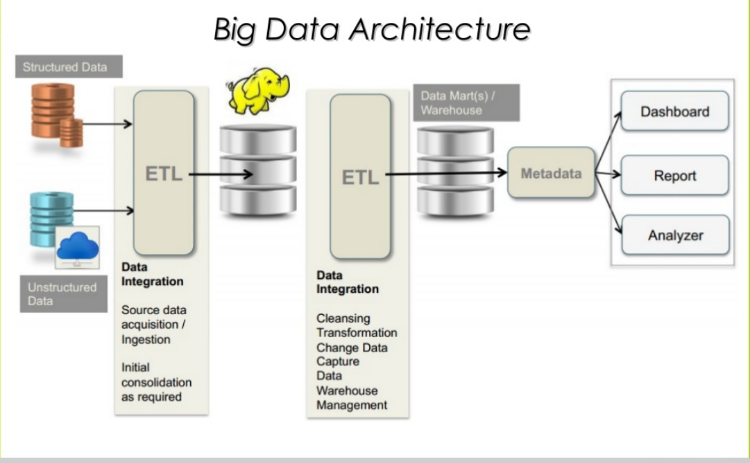
(ETL=extract, transform,load)

Slide 20
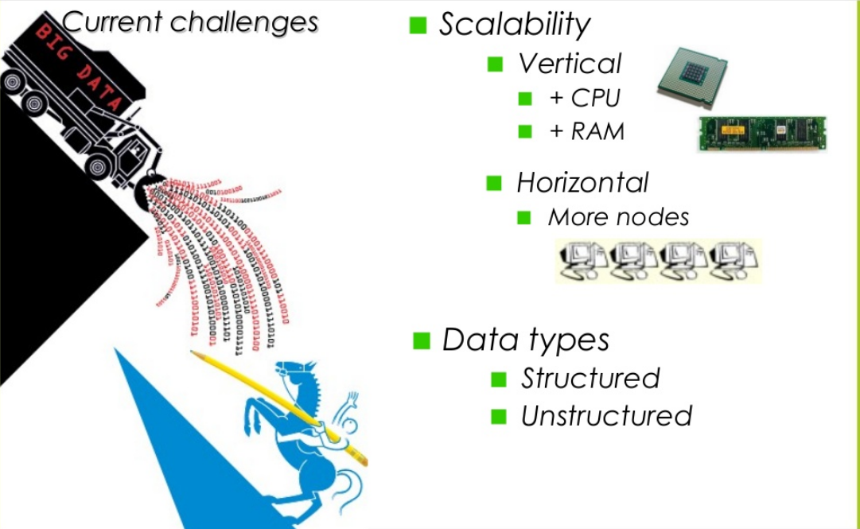
With big data

Slide 21
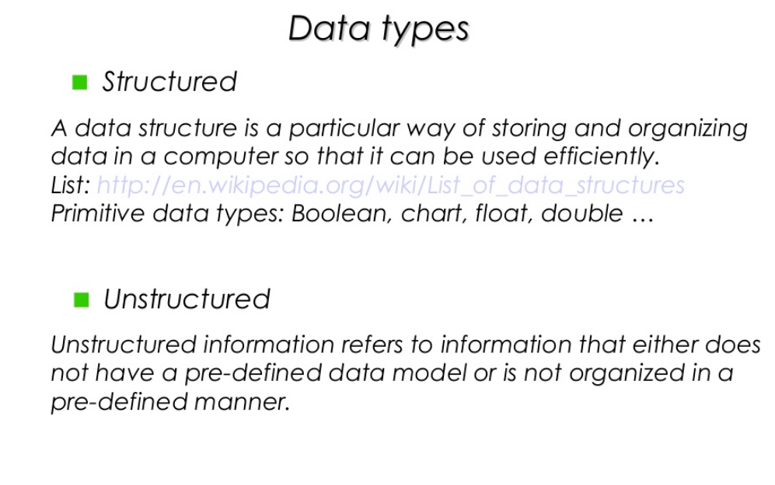
semi-structure….

Slide 22
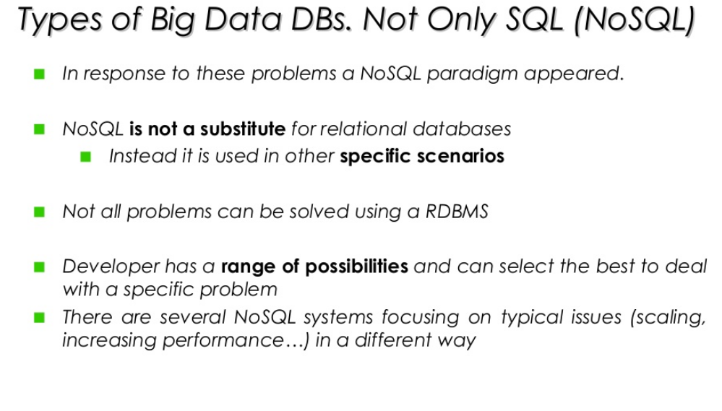

Slide 23
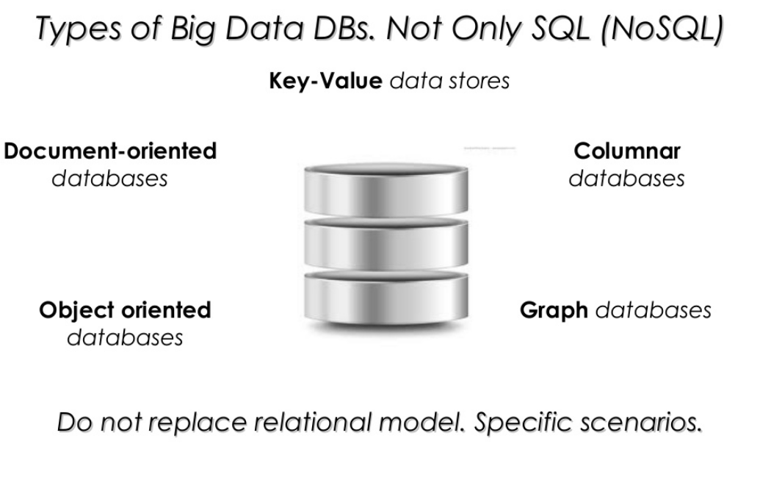
Example of NoSQL

Slide 24
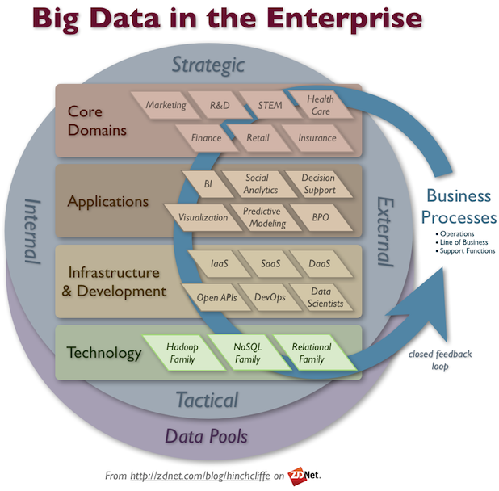

Slide 25
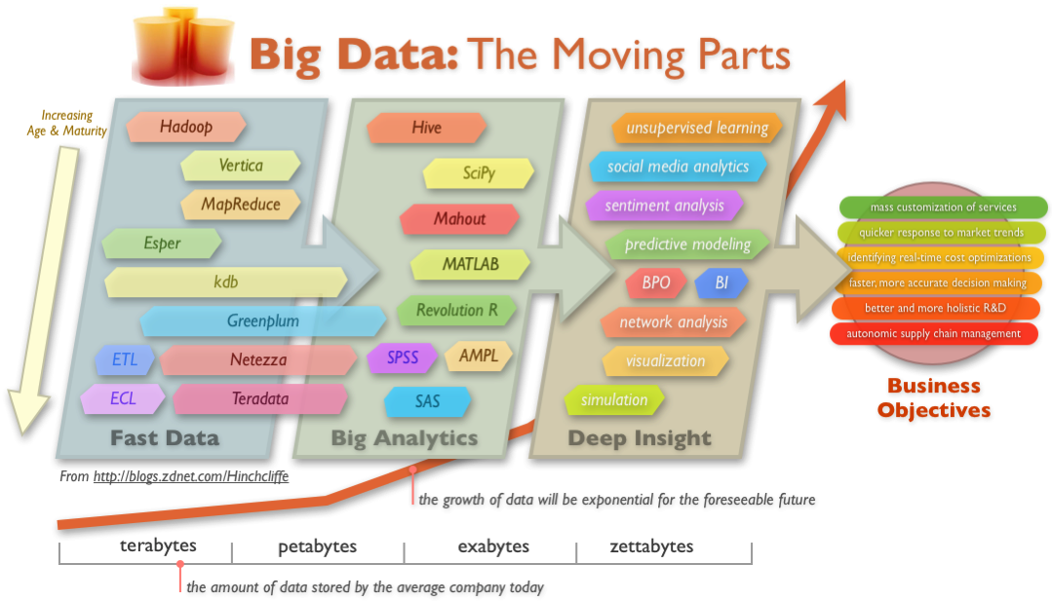
Target goal

Slide 26
Data Science

Slide 27
What is data science?
-Data Science is a field that comprises of everything that related to data cleansing, preparation, and analysis.
-Dealing with unstructured and structured data

Slide 28
Big Data: Big Data is humongous volumes of data that cannot be processed effectively with the traditional applications that exist.
Data Analytics: The science of examining raw data with the purpose of drawing conclusions.
It involves applying an algorithmic or mechanical process to derive insights.

Slide 29
Applications of data science
Internet search
Digital advertisement
Recommendation

Slide 30
Application of Big data
Big data in communication: Gaining new subscribers, retaining customers, and expanding within current subscriber bases
Big Data for financial services: Credit card companies, retail banks, private wealth management advisories, insurance firms, venture funds, and institutional investment banks use big data for their financial services.

Slide 31
Applications of Data Analysis:
-Healthcare
-Tourism
-Gaming
-Energy management
https://www.simplilearn.com/data-science-vs-big-data-vs-data-analytics-article

Slide 32
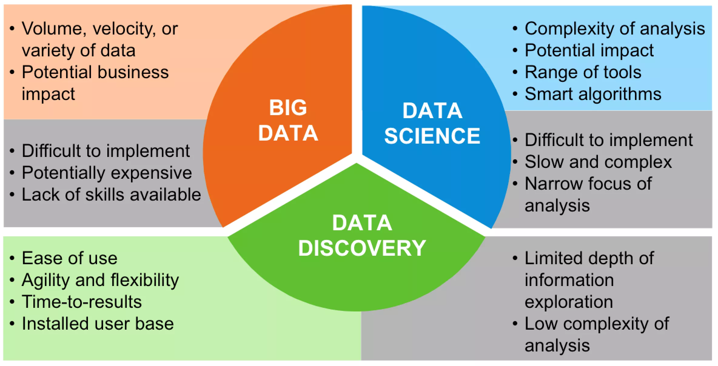

Slide 33
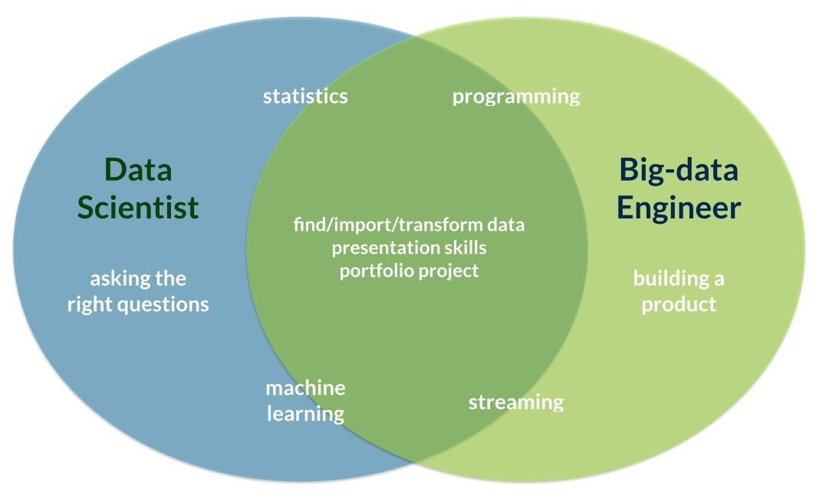

Slide 34
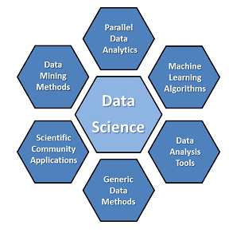

Slide 35

Our case study: IoT data
Monitoring inefficiency of energy consumption in data center.
Chantana Chantrapornchai
HPCNC Laboratory, Dept. of Computer Engineering
Kasetsart University
Withit Chatlatanakulchai, et.al.
CRVLAB , Dept. of Mechanical Engineering
Kasetsart University

Slide 36
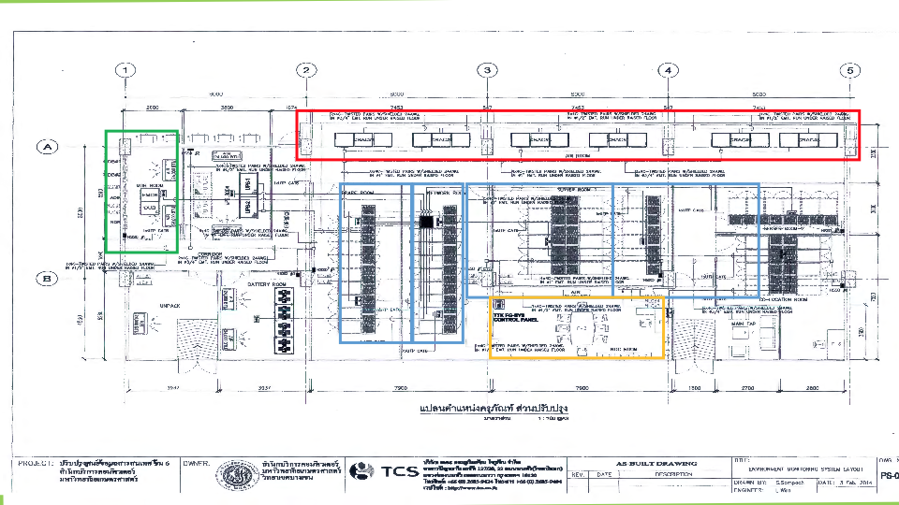
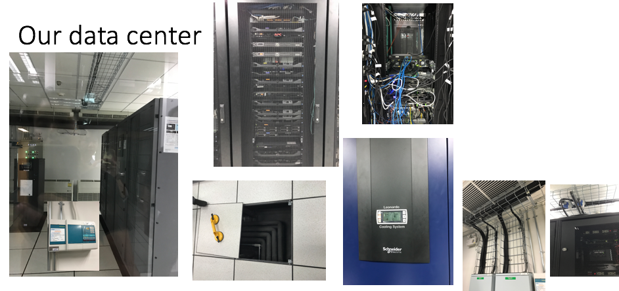

Slide 37
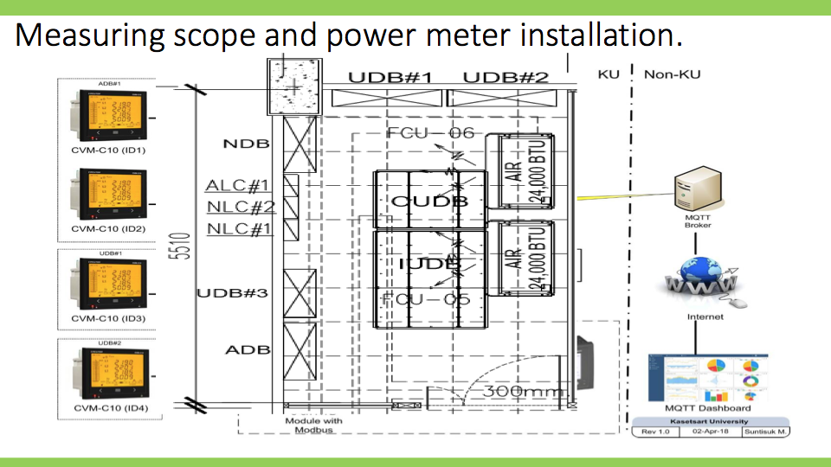

Slide 38
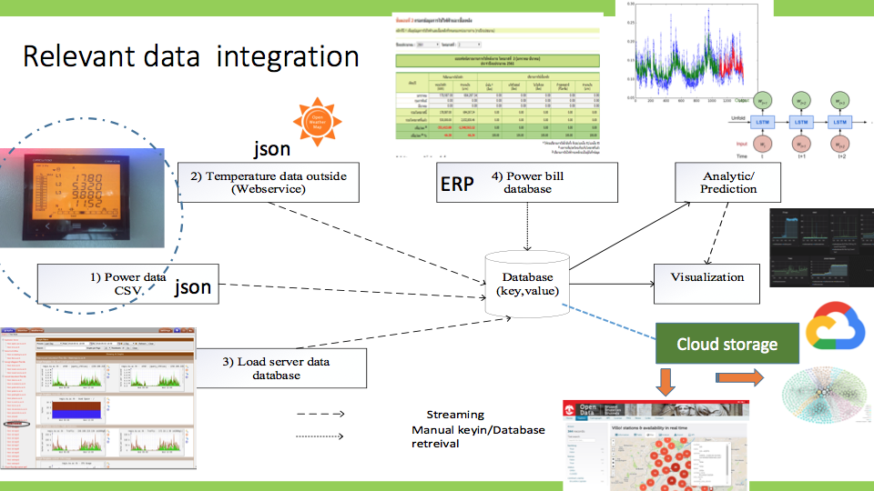

Slide 39
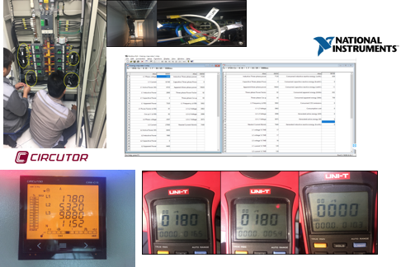
Meter installation

Slide 40
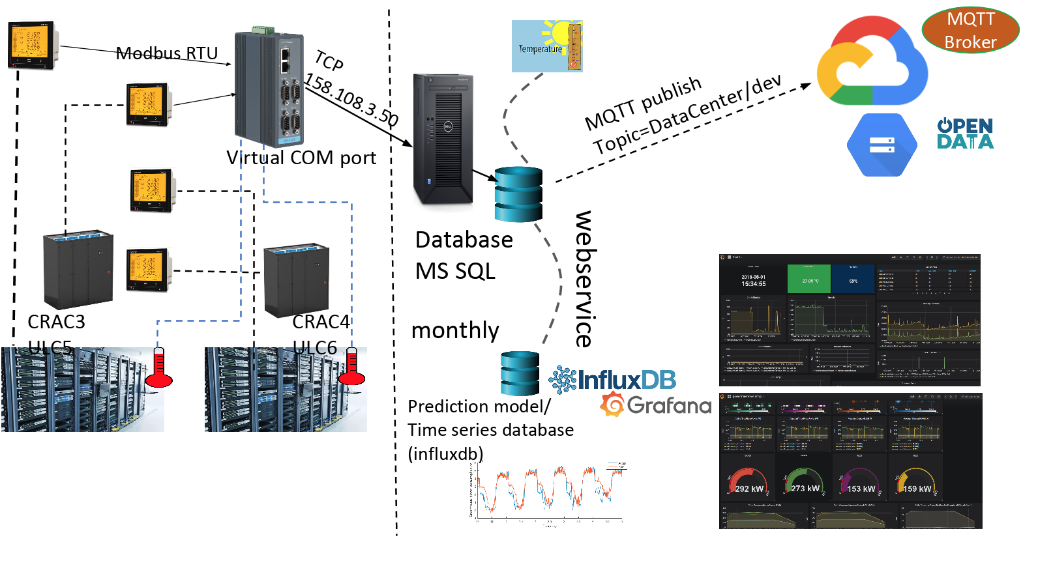

Slide 41
Visualization

Slide 42
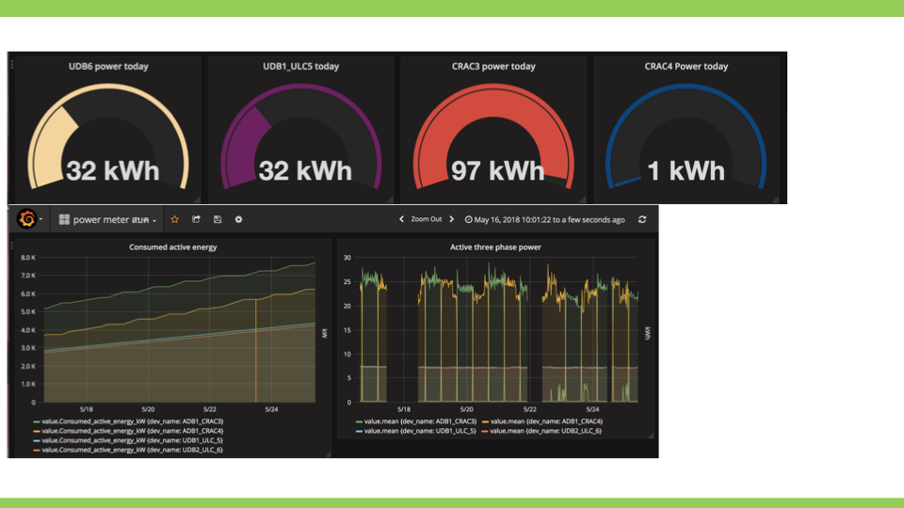

Slide 43
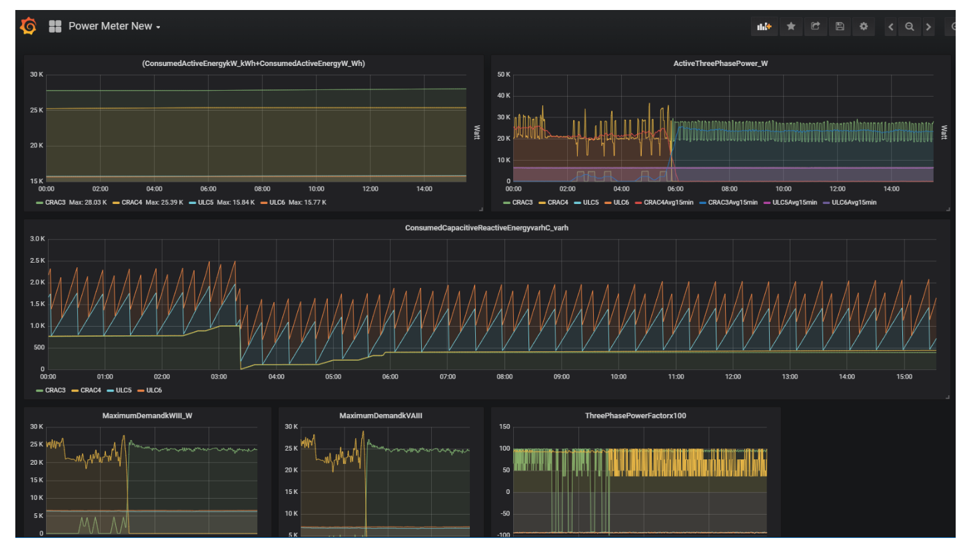

Slide 44
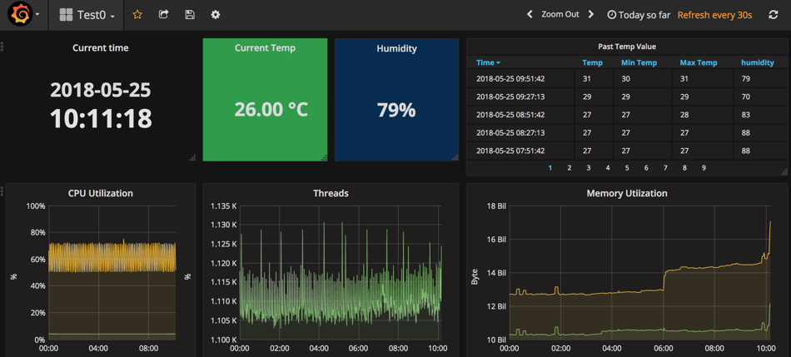

Slide 45
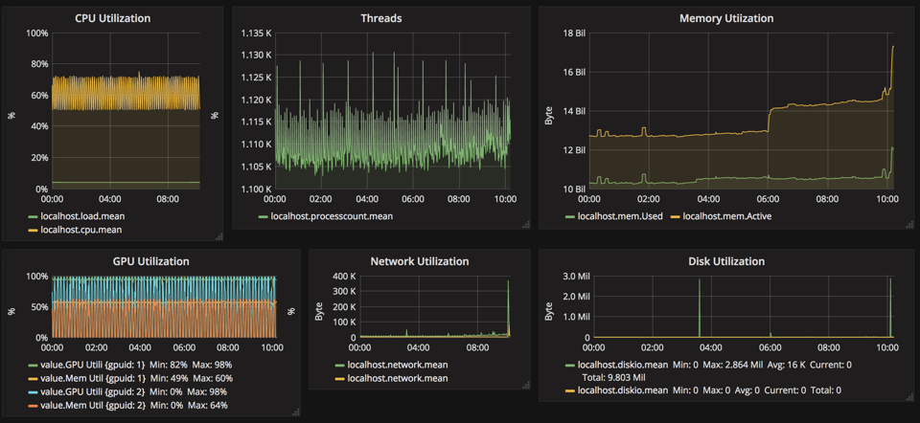

Slide 46
Let’s try out the data

Slide 47
Data Science Process
Data cleansing
Finding relationship
Modeling
Checking accuracy
Visualization

Slide 48
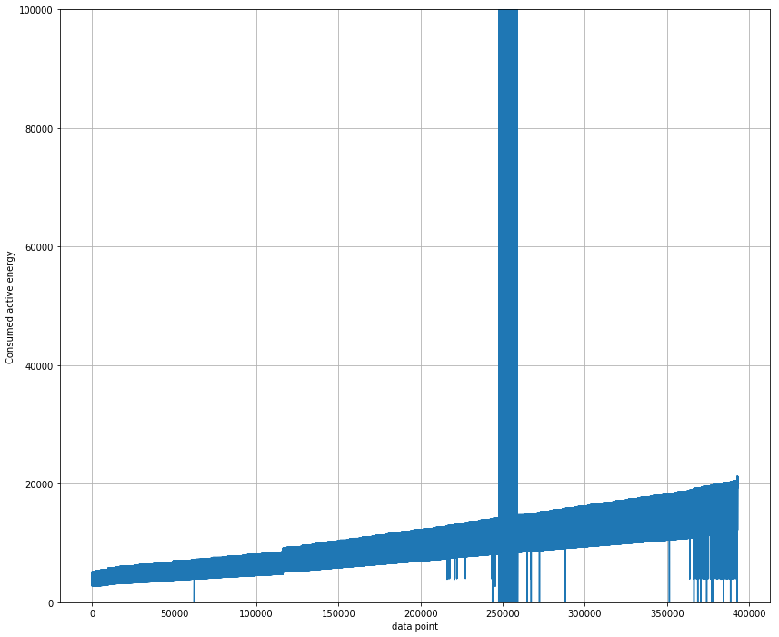
Cleansing
Remove noises
-Constraints (Max,Min)
-monotonically increasing
Missing data with resampling/interpolation
-Upsampling : Min -> Second
-Downsampling: Min -> Year

Slide 49
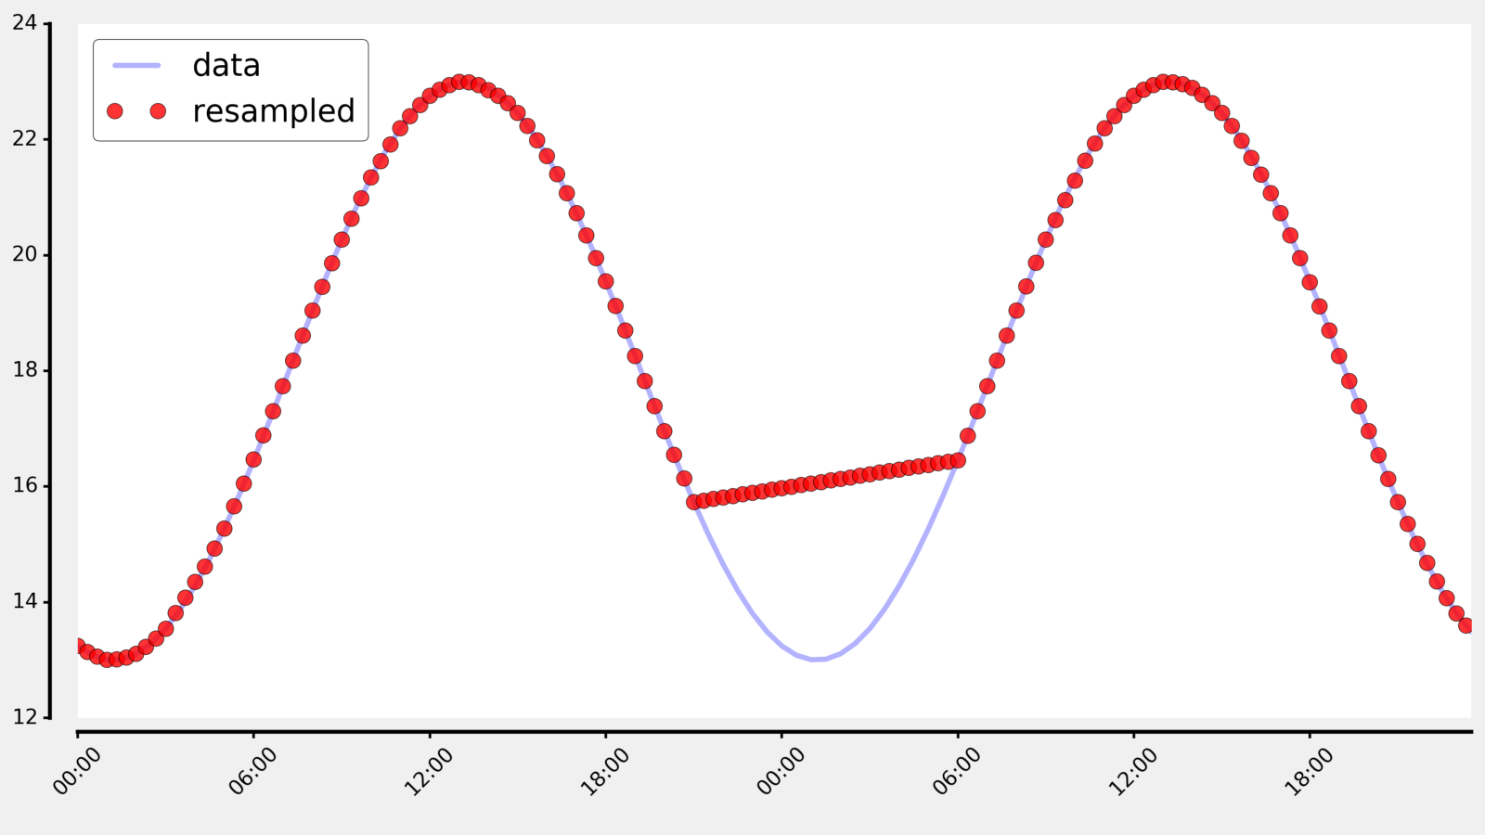
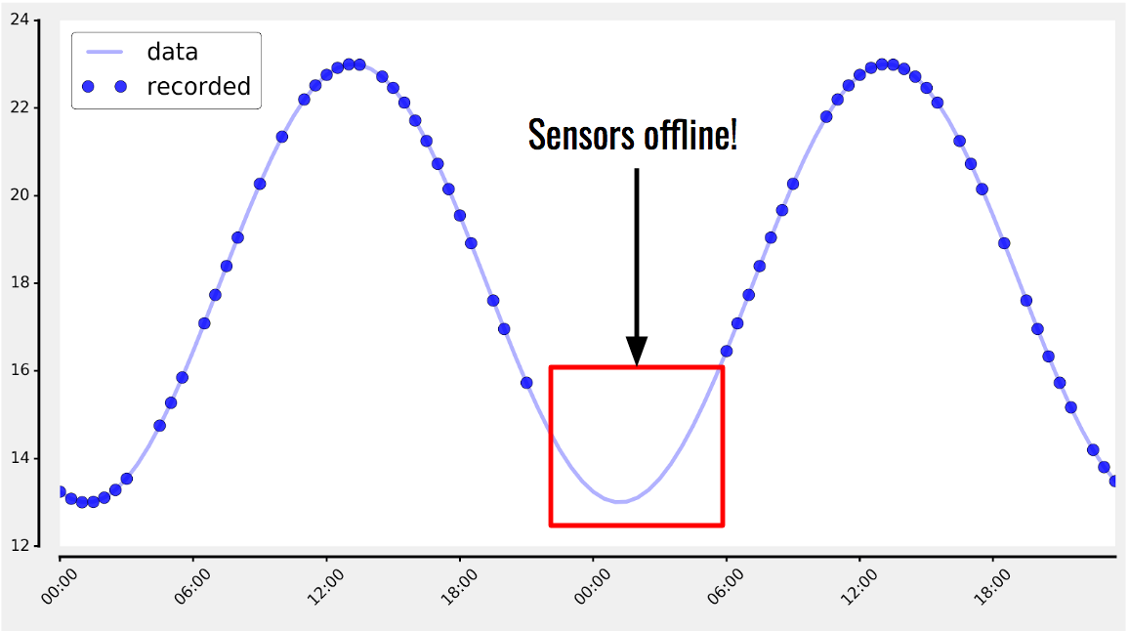
Wrong resample
6 hrs lost

Slide 50
Consumed_active_energy_kW Consumed_apparent_energy_kVAh \ Timestamp 2018-05-16 14:41:16 5180.0 5413.0 2018-05-16 14:41:46 5180.0 5413.0 2018-05-16 14:42:16 5180.0 5413.0 2018-05-16 14:42:46 5180.0 5413.0
original
Every 2 m
https://pandas.pydata.org/pandas-docs/stable/generated/pandas.DataFrame.resample.html
2018-07-06 05:48:00 5254.000000 2018-07-06 05:50:00 5254.000000 2018-07-06 05:52:00 5254.000000 2018-07-06 05:54:00 5255.000000
2018-05-16 17:30:00 5205.0 5439.0 2018-05-16 18:20:00 5227.0 5461.0 2018-05-16 19:10:00 5248.0 5483.0 2018-05-16 20:00:00 5269.0 5504.0 2018-05-16 20:50:00 5290.0 5526.0 2018-05-16 21:40:00 5312.0 5549.0
Every 50min

Slide 51
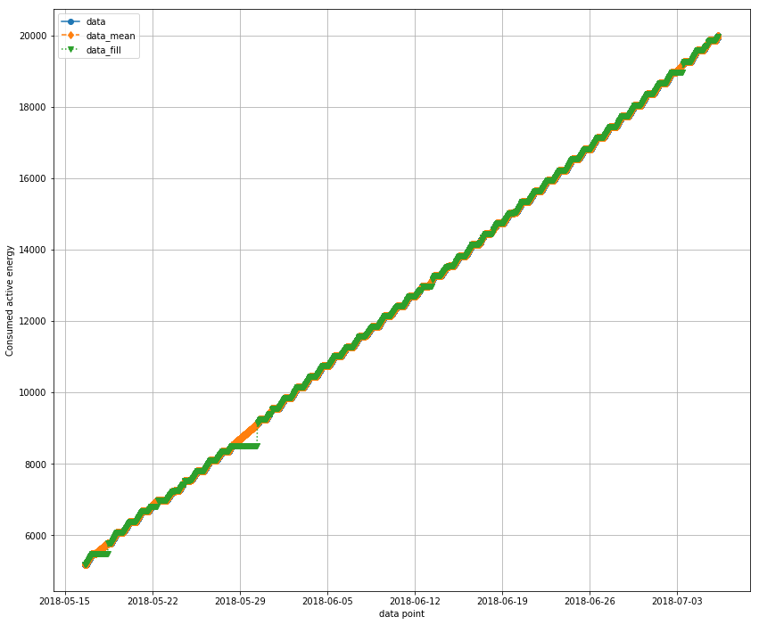

Slide 52
Finding relationships with existing attributes
Some analysis...

Slide 53
Multivariable linear regression

Slide 54
Finding correlation
It is a mutual relationship between quantities.
-Sales increases when increase marketing budget?
-Energy usages increase when temperature is high?
-Customer purchases more if there are packages promotions?
etc.
https://www.datascience.com/learn-data-science/fundamentals/introduction-to-correlation-python-data-science

Slide 55
Intro to correlation
It is a mutual relationship between quantities.
-Sales increases when increase marketing budget?
-Energy usages increase when temperature is high?
-Customer purchases more if there are packages promotions?
etc.
https://www.datascience.com/learn-data-science/fundamentals/introduction-to-correlation-python-data-science

Slide 56
Why we need correlation?
Help predict one quantity from another.
Indicate casual relationship.
Basic foundation to other modeling techniques.

Slide 57
Type of correlations
Covariances:
Covariance is a statistical measure of association between two variables X and Y.
Indicate the increase in the same direction.
if both variables tend to move in the same direction, we expect the "average" rectangle connecting each point (X_i, Y_i) to the means (X_bar Y_bar) to have a large and positive diagonal vector, corresponding to a larger positive product in the equation above.
E(X) = ∑X * P(X)

Slide 58
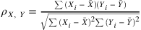
Pearson Correlation Coefficient
Pearson correlation measures the linear association between continuous variables.
This coefficient quantifies the degree to which a relationship between two variables can be described by a line.
Developed by Karl Pearson over 120 years ago.
subtracting their means and re-scaled by a measure of standard deviations.

Slide 59
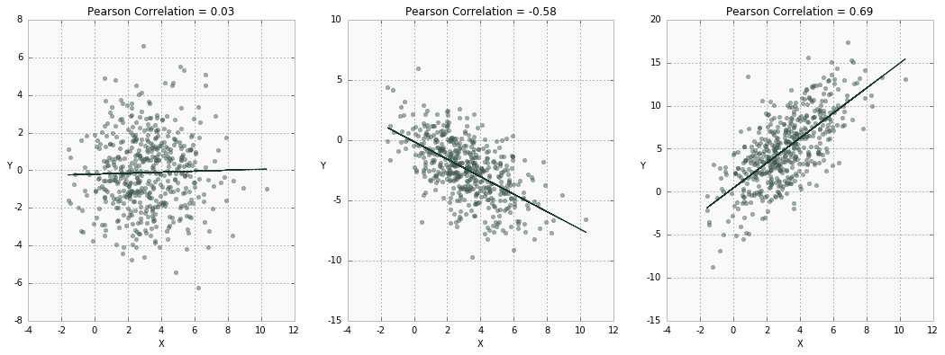
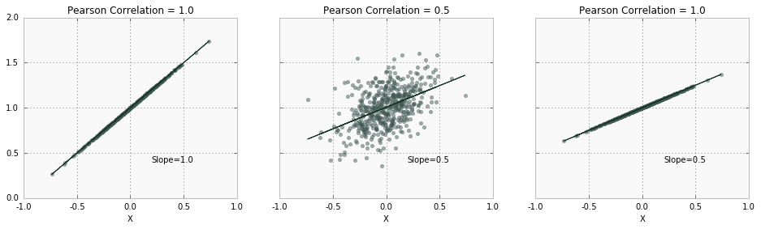
-Note that if X and Y are independent, then ρ is close to 0, but not vice versa!
-correlation does not equal slope
The closer ρ is to 1, the more an increase in one variable associates with an increase in the other.

Slide 60
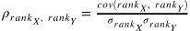
Spearman’s Correlation Coefficient
-Spearman's correlation is not restricted to linear relationships.
-it measures monotonic association (only strictly increasing or decreasing, but not mixed) between two variables and relies on the rank order of values.
Spearman's coefficient looks at the relative order of values for each variable.
Spearman's rank correlation coefficient can be defined as a special case of Pearson ρ applied to ranked (sorted) variables.

Slide 61
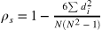
If all ranks are unique (i.e. there are no ties in ranks),
The simplified version:
where di = rank(Xi) - rank(Yi) ,is the difference between the two ranks of each observation and N is the number of observations.

Slide 62
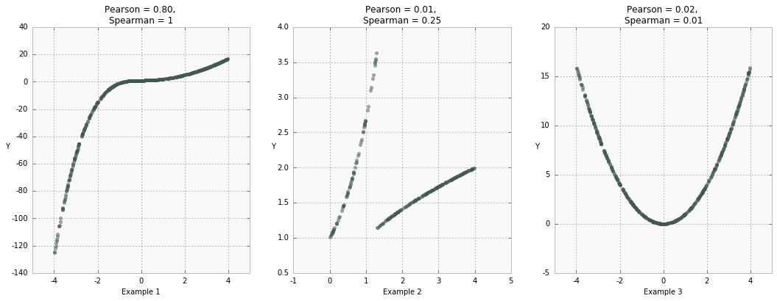
a clear monotonic (always increasing) and non-linear relationship.
clear groups in X and a strong, although non-monotonic, association for both groups with Y.
Pearson correlation is almost 0 since the data is very non-linear.
Spearman rank correlation shows a weak association since the data is non-monotonic.
a nearly perfect quadratic relationship centered around 0. However, both correlation coefficients are almost 0 due to the non-monotonic, non-linear, and symmetric nature of the data.

Slide 63
Kendall's Tau Coefficient
Kendall's τ does not take into account the difference between ranks — only directional agreement. Therefore, this coefficient is more appropriate for discrete data.

Slide 64
Concordant pairs (x1, y1), (x2, y2) are pairs of values in which ranks coincide: x1< x2 and y1 < y2 or x1 > x2 and y1 > y2.
Here (4,6) and (5,9) in rows d and e is a concordant pair.
| | X | Y | |--|------|----| |a | 1 | 7 | |b | 2 | 5 | |c | 3 | 1 | |d | 4 | 6 | |e | 5 | 9 |
To calculate the numerator of τ, we compare all possible pairs in the dataset and count number of concordant pairs; 6 in this case:
(1,7) and (5,9)
(2,5) and (4,6)
(2,5) and (5,9)
(3,1) and (4,6)
(3,1) and (5,9)
(4,6) and (5,9)
Discordant pair
(1,7) and (2,5)
(1,7) and (3,1)
(1,7) and (4,6)
(2,5) and (3,1)

Slide 65
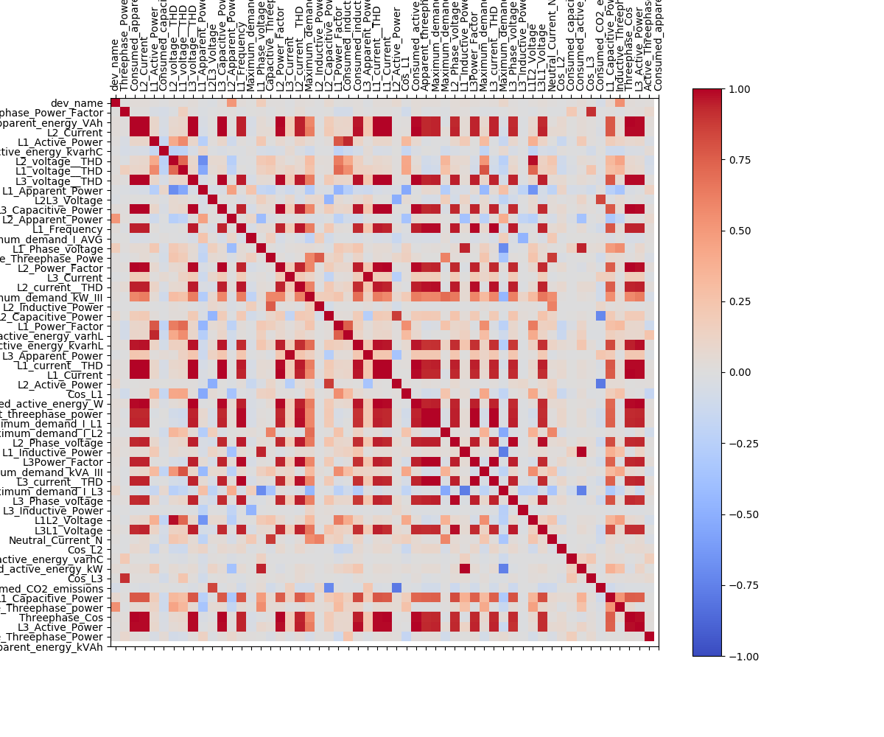
Visualization of relation

Slide 66
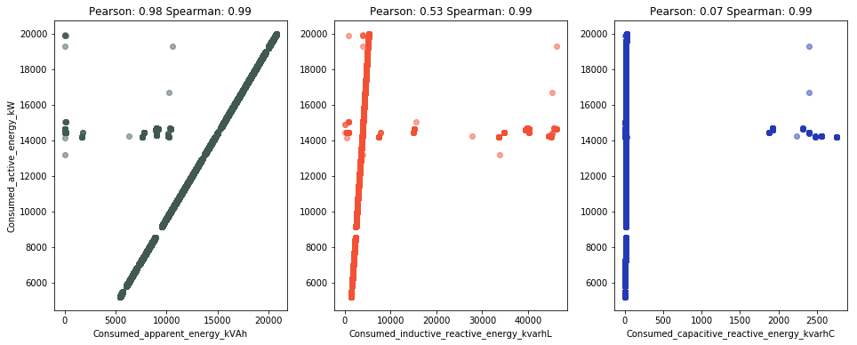

Slide 67
Top 20 features from correlation
Consumed_apparent_energy_kVAh 0.981747 Consumed_inductive_reactive_energy_kvarhL 0.528266 Consumed_capacitive_reactive_energy_kvarhC 0.068560 L2_voltage__THD 0.067717 Cos_L1 0.052542 L2_current__THD 0.050298 L1_current__THD 0.047905 Consumed_CO2_emissions 0.039708 Consumed_capacitive_reactive_energy_varhC 0.039587 L1_Power_Factor 0.035377 Threephase_Cos 0.034699 L1_Capacitive_Power 0.031062 L3_Phase_voltage 0.027613 Capacitive_Threephase_Powe 0.026782 Cos_L2 0.026488 Cos_L3 0.024519 L3Power_Factor 0.024410 L3_Apparent_Power 0.023013 Maximum_demand_I_L3 0.021808 L2_Power_Factor 0.021571

Slide 68
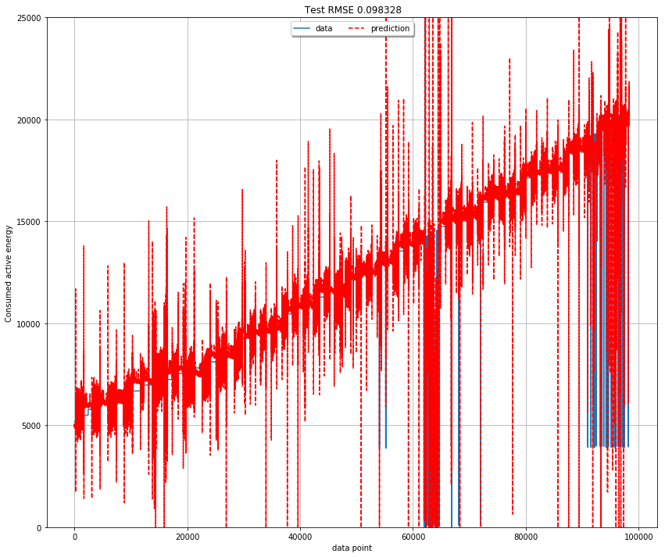
Linear regression1

Slide 69
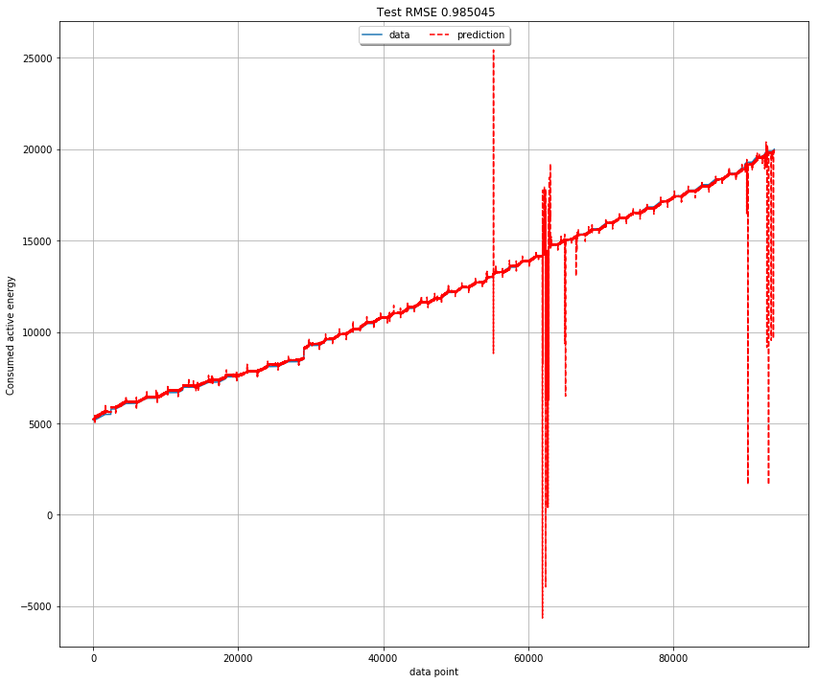
Linear regression2-- clean data

Slide 70
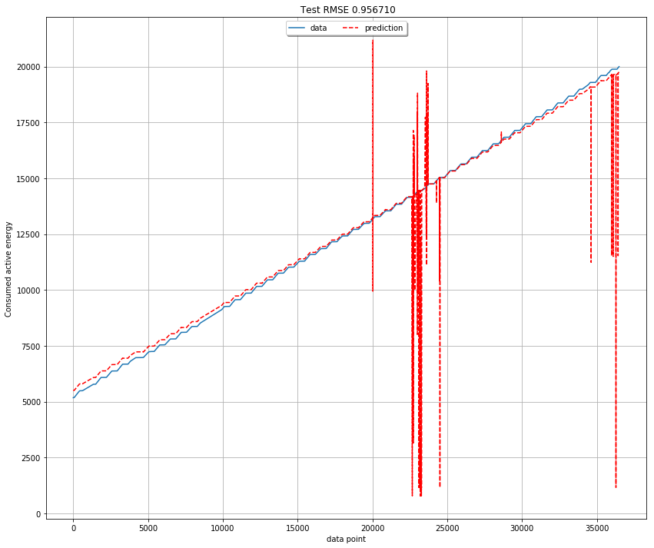
cols = ['Consumed_apparent_energy_kVAh', 'Consumed_inductive_reactive_energy_kvarhL','Consumed_capacitive_reactive_energy_kvarhC']
Linear regression3- clean+resampling
Resampling with multicolumn

Slide 71
2. Autoregression

Slide 72
Autoregression
Time series data
Predict x(t+1) from x(t-2), x(t-1), x(t)
--Finding autocorrelation

Slide 73
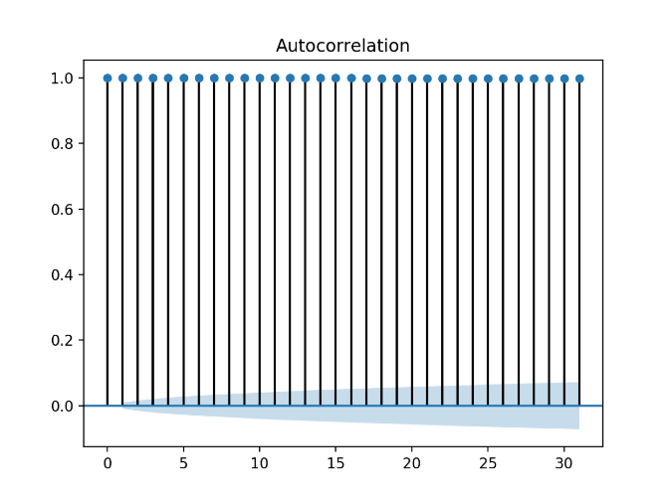
Autocorrelation
 | X(t-1) | X(t+1)
X(t-1) | 1.0 | 1.0
X(t+1) | 1.0 | 1.0
good!
Lag=31

Slide 74
Stationary analysis
-Testing whether the data is stationary. It has the constant average/moving average
-Use Dickey Fuller test
Results of Dickey-Fuller Test:
Test Statistic -0.061172
p-value 0.953171
#Lags Used 55.000000
Number of Observations Used 45332.000000
Critical Value (5%) -2.861604
Critical Value (1%) -3.430494
Critical Value (10%) -2.566804
Test statistics -0.061172 should be less than Critical Value (1%)

Slide 75
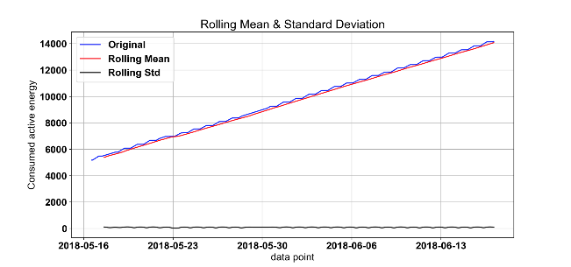


Slide 76

Solving non-stationary
-Take difference (first order diff : with prev value)

Slide 77
Test Statistic -8.922295e+00
p-value 1.033276e-14
#Lags Used 5.500000e+01
Number of Observations Used 4.389300e+04
Critical Value (5%) -2.861606e+00
Critical Value (1%) -3.430499e+00
Critical Value (10%) -2.566805e+00
Better!!

Slide 78

Prediction with autoregression

Slide 79
https://cocalc.com/projects/
Free Jupyter project: jupyter lab
git clone https://github.com/cchantra/datascience_tutorial.git
Or goto https://github.com/cchantra/datascience_tutorial
Download each file to your desktop
And run jupyter

Slide 80
About Data Science in KU
KU Data Science Bootcamp
KU Data Science Forum
KU Data Science Education
KU Open data
http://datascience.ku.ac.th

Slide 81



Slide 82

http://datascience.ku.ac.th

Slide 83

https://www.facebook.com/KU-Data-science-boot-camp-2018-356005521545466/?ref=bookmarks

